Slide 1
Cassandra Tools and Distributed Administration
Dr. Jeffrey Berger
Lead Database Engineer
Knewton

Slide 2
1 | Introduction
2 | Why command-line tools?
3 | cassandra-stat
4 | cassandra-tracing
5 | Ansible ad-hoc commands

Slide 3

Knewton
Leader in adaptive learning
Partners with publishers and institutions in Europe, US, and Asia
Provides unique recommendations to students based on previous behavior
Advanced content ingestion, curation, and calibration
Runs in AWS with many different storage backends
Check us out: www.knewton.com/about/careers/

Slide 4
Cassandra at Knewton
Cassandra is the main datastore at Knewton
Development
QA
User Acceptance
US Production
EU Production
Clusters: 2
Nodes: 6
Clusters: 6
Nodes: 24
Clusters: 6
Nodes: 18
Clusters: 6
Nodes: 69
Clusters: 5
Nodes: 15
Clusters: 25 Nodes: 132
Notes:
note cassandra's scale at knewton. We're not netflix but this isn't a small deployment, and we've been using it for 3+ years. Node counts fluctuate often for traffic considerations.
Cassandra isn't the only datastore at knewton (dynamo, mysql, postgres)

Slide 5
Cassandra Challenges
Monitoring
Historical measures are important
Triage
Immediate answers in a distributed system
Provisioning
Keep configurations consistent
Scaling
Elastically scale Cassandra 'out' or 'in'
Notes:
Cassandra has all the challenges of a distributed system, nothing is for free

Slide 6
Cassandra Challenges
Monitoring
Historical measures are important
Triage
Immediate answers in a distributed system
Provisioning
Keep configurations consistent
Scaling
Elastically scale Cassandra 'out' or 'in'
Cassandra is a distributed system
Notes:
Don't be surprised that you have distributed problems in a distributed system

Slide 7

Solutions as Software
If you magnify your surface area,
magnify your tools
Easy to use
Fast and responsive
Distributed
Notes:
Upgrade your tools, you can't let your capabilities fall behind your systems - don't be afraid of more powerful tools
Some examples of tools that are each of these catagories are:
ex: ls / ps
ex: top
ex: ssh / xargs

Slide 8
1 | Introduction
2 | Why command-line tools?
3 | cassandra-stat
4 | cassandra-tracing
5 | Ansible ad-hoc commands

Slide 9
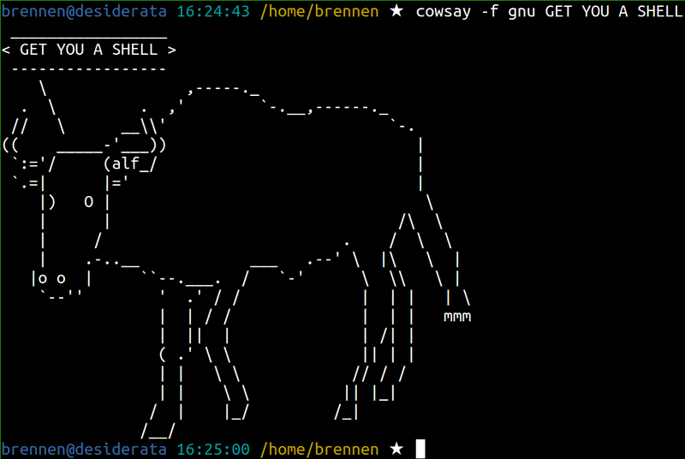
Why command line tools?
Always consider the operator!
Systems people like the command line!
Few moving parts
Local
Immediate
Notes:
The command line image is a shot of cowsay - so that is an ASCII Cow - everyone loves CLI

Slide 10
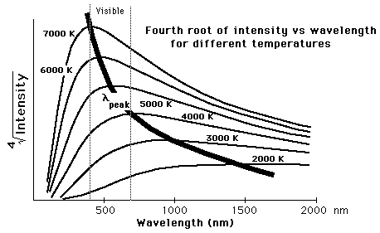
Why not graphs?
Graphs are great, I love graphs
Not immediate
Can be overloaded
Remote
Fixed metrics
Averages rather than values

Slide 11

Why not nodetool?
Nodetool is great..
Notes:
nodetool does everything from removing nodes to outputting metrics, but because it does everything it doesn't excel at some things

Slide 12

Why not nodetool?
Until it is time to cook dinner...
Notes:
Specific problems or needs require specific tools, don't try and just use one thing for all of your management. You don't use just one program to run your system.

Slide 13
Jolokia ( jolokia.org )
Exposes JMX endpoints by HTTP
Open source (Apache2)
Lets you script with full access to JMX endpoints
Agent runs with cassandra
Lightweight, fast, easy to install
Notes:
All cassandra metrics are JMX which makes it hard for anything other than a java process to access them and that isn't the favorite tool of admins. Scripts are great, but that means we can't get to JMX metrics - but we can use jolokia.

Slide 14
Installing Jolokia is painless
1) Download the Jolokia JVM agent from their site / maven
2) Add this line to cassandra-env.sh
# added to activate the jolokia agent
JVM_OPTS="$JVM_OPTS -javaagent:/opt/cassandra/jolokia-jvm-agent.jar"
(Or whatever the path is to your Jolokia JVM jar!)

Slide 15
What to do with Jolokia?
Build some monitoring tools!
Use jconsole to find metrics you are interested in
Make some programs with your favorite language
Get the metrics from Jolokia to feed it
Check out the tools we have already made!

Slide 16
cassandra-toolbox
Python package of cassandra tools developed at Knewton
Pip installable
pip install cassandra-toolbox
Open source (Apache2)
Interacts with C* via Jolokia
github.com/Knewton/cassandra-toolbox
2 scripts right now, more soon

Slide 17
1 | Introduction
2 | Why command-line tools?
3 | cassandra-stat
4 | cassandra-tracing
5 | Ansible ad-hoc commands

Slide 18
cassandra-stat
A real-time feed of Cassandra operations
Like iostat for Cassandra
Interacts with Jolokia agent
Diffs metrics on a configurable time scale
Overall / Keyspace / CF granularity
Easy to use, easy to read

Slide 19
cassandra-stat
*Not all fields shown
$cassandra-stat
Reads Writes Reads (99%) ms Writes (99%) ms Compactions Time ns
1 111 91.462 17.4 0 20:15:36 total
2 113 91.4 17.98 0 20:15:37 total
0 117 91.4 17.17 0 20:15:38 total
0 72 91.4 17.34 0 20:15:39 total
0 69 91.4 17.3 0 20:15:40 total
Some metrics are summed across CFs and the difference from the last iteration reported
Some metrics are summed across CFs
Some report the maximum value from all CFs
Notes:
All metrics are defined in a configuration file if they have the max value of all keyspaces reported, if they report the value as of this moment, or if they report the difference between this value and the previous.

Slide 20
cassandra-stat
Metrics are not hardcoded
Easy to add/remove
Flexible
sum
diff
nonzero
Configuration is moving to a YAML file
metrics = [
{
"metric_name": "ReadLatency",
"metric_key": "Count",
"display_name": "Reads",
"sum": True,
"diff": True,
"nonzero": True
},
...
Notes:
The default behavior is to output the current maximum of all CFs that are within a given superset (for total, all CFs, for a keyspace all CFs within that keyspace, and for a CF it simply outputs the value for that CF)
Sum = Add up all values from a given set
diff = take the difference between the metric and the previous value of the metric that the program has calculated
nonzero = This field is expected to be nonzero. if all expected nonzero fields are actually zero the set is excluded from output. useful for only displaying CFs/Keyspaces that have activity on them (reads/writes for example)

Slide 21
cassandra-stat
Benefits:
Traffic monitoring
Real time load can be read off easily
Performance debugging
All vital metrics are on a single line at each time
High granularity
Metrics every second
Diverse metrics
Metrics can be configured and read out immediately

Slide 22
1 | Introduction
2 | Why command-line tools?
3 | cassandra-stat
4 | cassandra-tracing
5 | Ansible ad-hoc commands

Slide 23
cassandra-tracing
* Don't set this percent too high!
Sampling a percent of all queries is a great tool*
$nodetool settraceprobability 0.001
But if you ever queried the CFs in system_traces you might be bewildered..
Notes:
Explain what trace probability is

Slide 24
cassandra-tracing
cqlsh:system_traces> SELECT request,parameters FROM sessions LIMIT 4; request | parameters --------------------+--------------------------------------- Execute CQL3 query |
{'consistency_level': 'LOCAL_ONE', 'page_size': '5000', 'query': 'SELECT * FROM test2 WHERE key=''XXXXXXXXXXXXXXXXX''', 'serial_consistency_level': 'SERIAL'}
Execute CQL3 query |
{'consistency_level': 'ONE', 'query': 'select cluster_name from system.local', 'serial_consistency_level': 'SERIAL'}
Execute CQL3 query |
{'consistency_level': 'ONE', 'query': 'select cluster_name from system.local', 'serial_consistency_level': 'SERIAL'}
Execute CQL3 query |
{'consistency_level': 'ONE', 'query': 'SELECT * FROM system.schema_columnfamilies', 'serial_consistency_level': 'SERIAL'}
Notes:
This information that is generated by cassandra is bulk program output and is difficult to parse for a human. Cassandra also doesn't allow us to do aggregation in cqlsh so we can't do sorting and groupings which makes it very hard to find something when we don't know what we are looking for exactly.

Slide 25
cassandra-tracing
cqlsh:system_traces> SELECT request,parameters FROM sessions LIMIT 4; request | parameters --------------------+--------------------------------------- Execute CQL3 query |
{'consistency_level': 'LOCAL_ONE', 'page_size': '5000', 'query': 'SELECT * FROM test2 WHERE key=''XXXXXXXXXXXXXXXXX''', 'serial_consistency_level': 'SERIAL'}
Execute CQL3 query |
{'consistency_level': 'ONE', 'query': 'select cluster_name from system.local', 'serial_consistency_level': 'SERIAL'}
Execute CQL3 query |
{'consistency_level': 'ONE', 'query': 'select cluster_name from system.local', 'serial_consistency_level': 'SERIAL'}
Execute CQL3 query |
{'consistency_level': 'ONE', 'query': 'SELECT * FROM system.schema_columnfamilies', 'serial_consistency_level': 'SERIAL'}
Let a program deal with it!

Slide 26
cassandra-tracing
*Not all fields shown
$ cassandra-tracing `hostname -I ` 100% Complete: XXXXXXXXXXXXXXXXXXXXXXXXXXXXXXXXXXXXXXXXXXXXXXXX|100 Total skipped due to null duration: 0 Total skipped due to error: 0 175 sessions satisfying criteria. Showing 100 longest running results. Session Id Duration(us) Query UUID 19696 SELECT * FROM system.schema_columnfamilies UUID 20569 Executing single-partition query on ColumnFamilyA UUID 20905 SELECT * FROM system.schema_columnfamilies UUID 21056 Executing single-partition query on ColumnFamilyB UUID 21397 Executing single-partition query on ColumnFamilyB UUID 21992 Executing single-partition query on ColumnFamilyC ...
Session id allows introspection into individual operations in system_traces
Longest duration queries shown last
Notes:
This does a table scan by necessity of the design of the data structure in the CFs so even though thresholds can be set in the application that will only affect what is presented to the user not what it executes on the database.

Slide 27
cassandra-tracing
cqlsh:system_traces> select activity,source_elapsed from events WHERE session_id=UUID; activity | source_elapsed ---------------------------------------------------------------+--------------- Parsing SELECT * FROM system.schema_columnfamilies | 21 Preparing statement | 31 Computing ranges to query | 73 Submitting range requests on 1 ranges with a concurrency of 1 | 88 Submitted 1 concurrent range requests covering 1 ranges | 96 Executing seq scan across 3 sstables for [min(-1), min(-1)] | 382 Read 7 live and 0 tombstone cells | 2057 Read 2 live and 0 tombstone cells | 2495 Read 1 live and 0 tombstone cells | 3066 Read 17 live and 32 tombstone cells | 16892 Read 7 live and 0 tombstone cells | 18757 Scanned 5 rows and matched 5 | 19172
Notes:
Query the session identified in the cassandra tracing program allows us to evaluate much more meaningful data

Slide 28
cassandra-tracing
Benefits:
High level view of traffic passing through the node
Does a single query type take a long time?
Are you hitting a lot of tombstones with a query type?
Index usage? Timeouts?
Meaningful introspection
Isolate the sessions that are interesting cases and spend your time on the queries driving up your %99.9.

Slide 29
1 | Introduction
2 | Why command-line tools?
3 | cassandra-stat
4 | cassandra-tracing
5 | Ansible ad-hoc commands

Slide 30
Ansible (www.ansible.com)
An agentless, open source, ssh-based, configuration management tool.
We use it for backups / provisioning / distributed commands.
Go check out: Cassandra backups and restorations using Ansible
Joshua Wickman
4:10 PM – 4:45 PM Room 210B
Notes:
ssh + xargs is black magic and not everyone will be comfortable using it - but you can do the distributed commands with that instead.

Slide 31
Ad Hoc commands
Ad hoc commands are one-off command line processes
ansible cassandra -i ips.txt -m shell -a "hostname"
Yaml file of groups of ips
Command to execute on the remote host
Name of ip group to execute on
Using the shell module
IP List can be a script that returns the IPs, so it can tie into any inventory management

Slide 32
Ad Hoc commands
Output looks like:
172.ip.ip.ip| success | rc=0 >> cassandra-i-962LMNOP 172.ip.ip.ip | success | rc=0 >> cassandra-i-dbfLMNOP 172.ip.ip.ip | success | rc=0 >> cassandra-i-450LMNOP
Success or failure of command
Return code of command
Able to be piped through grep or other processes on your local machine

Slide 33
Distributed Arbitrary Commands
Make a wrapper function - make it easy on your team!
dcmd = distributed command
function dcmd(){ if [[ $# < 2 ]]; then echo "USAGE dcmd <GROUP> <SHELL COMMAND>
Ex: dcmd qa-cass 'tail /var/log/cassandra/system.log'"; else ansible "${1}" -i ips.txt -m shell -a "${2}" --sudo; fi }

Slide 34
Distributed Commands
Benefits:
Get immediate status on distributed systems
Output reflects the current state
Execute operations on all nodes
If you need to bounce a whole cluster, this is great
Easy to see differences between node output
Cassandra is distributed so all nodes might not agree on the state of the cluster. It can be hard to find the dissenting node(s).

Slide 35
Distributed Nodetool Commands
$dcmd qa-cass 'nodetool tpstats | egrep "AntiEntropy|Name"'
172.ip.ip.ip | success | rc=0 >>
Pool Name Active Pending Completed Blocked All time blocked
AntiEntropyStage 0 0 0 0 0
172.ip.ip.ip | success | rc=0 >>
Pool Name Active Pending Completed Blocked All time blocked
AntiEntropyStage 0 0 0 0 0
172.ip.ip.ip | success | rc=0 >>
Pool Name Active Pending Completed Blocked All time blocked
AntiEntropySessions 0 0 1536 0 0
AntiEntropyStage 0 0 126720 0 0
Notes:
What if we think that a repair is stuck on a certain node, that it hasn't finished a repair session but it should have. This can show us quickly which node(s) have repair sessions and which don't. Here we can see one node has executed a lot of repairs and the others have never done this.

Slide 36
Conclusions
Cassandra exposes a lot of metrics if you know where to find them - don't be afraid to dig them out!
Programs can analyze bulk output a lot faster and better than people - save your time for the things programs aren't good at.
Have distributed commands in your arsenal and don't be afraid to use them.

Slide 37
Thank You

